Slide 1
Ransomware Affiliate Orientation
Andrew Lemon
@lemonitup
https://www.linkedin.com/in/lemonitup/
Notes:
Thank you for coming to Ransomware Orientation: How to Infect and Extort Companies. Ransomware has moved out of the basement and has become an organized business OR organized crime with payout structures and hierarchy. The purpose of this presentation is a satirical performance of what I expect an affiliates first day with a ransomware company looks like. Based on my experience in incident response and my interactions with threat actors using sock puppet accounts I’d like to give you a behind the scenes tour. I targeted this presentation at 45 minutes to leave time for questions.

Slide 2
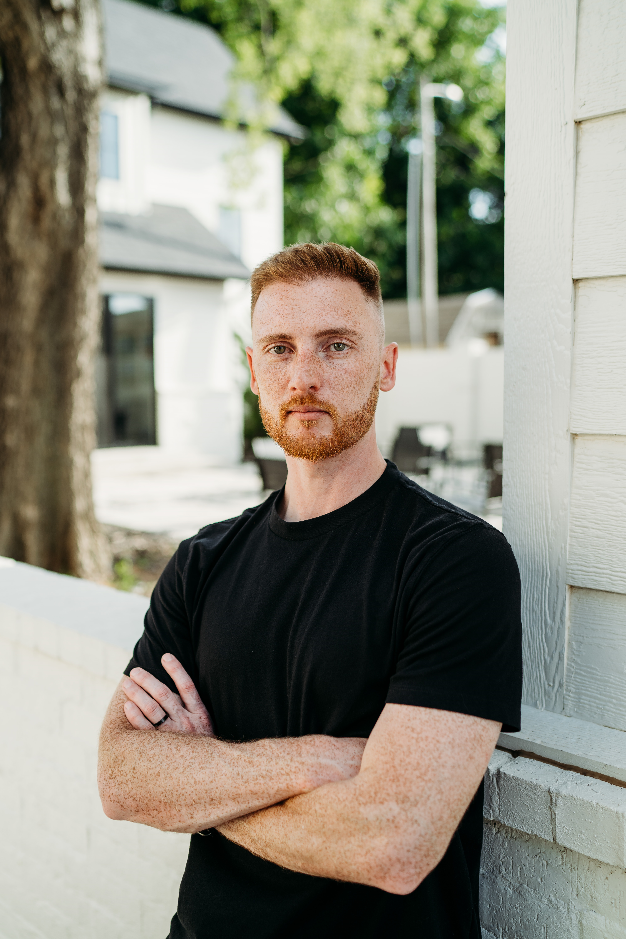
WHOAMI
Principal Security Engineer/CEO of Red Threat
10 years of Security Experience (Paid)
20 years of Security Experience “Unpaid”
Fun Fact: 3 career Goals
Talk at Defcon
Get a CVE
Steal a ‘fake’ baby (legally; on a physical pentest)
Notes:
Take 5 minutes you have time
I’ve worked some of the biggest breaches you never heard of. I’ve worked a bunch of breaches you saw on the news. I’ve taken part in countless negotiations and had to personally buy large sums of bitcoin to facilitate a ransom payment which by the way makes your tax filings for the next year a nightmare. Try explaining why a company wired half a million dollars to your personal account that you immediately moved to an online crypto exchange and then transferred to a wallet associated with known cyber criminals.
I had lunch with an attorney friend who told me this was some seriously dangerous stuff and I needed to put a disclaimer on the entire presentation. So here it is.

Slide 3
!DISCLAIMER!
The content provided in this hacking class is intended solely for malicious purposes to enhance the balance of your crypto wallets. Attendees and participants are strictly cautioned against utilizing any techniques, methodologies, or information learned in this class for blue team activities. Any defensive knowledge gained from this presentation is an unintended consequence. No seriously that’s a joke don’t be a jerk.
Notes:
This is satire. I’ll be playing a part. So without further a do

Slide 4

Welcome to your first day at
The industry leader in encryption
Notes:
According to the FBI ransomcorp has been implicated in 1700 encryption events since 2020… Those are rookie numbers
Between June 2021 and January 2022 we actually successfully deployed our encryption software to 2,915 organizations in the US
The FBI estimates our earnings this year at 91 million but like all things they don’t want egg on their face because that number is also wrong

Slide 5
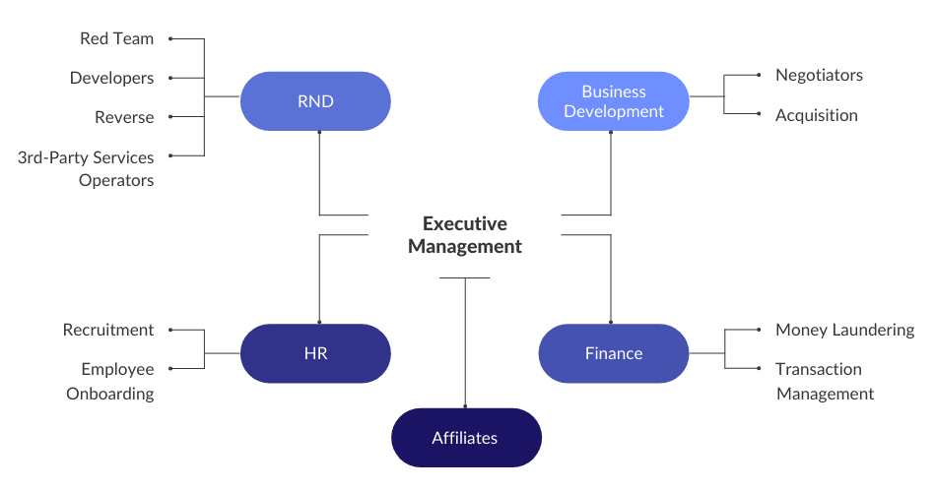
About the company
Notes:
Ransom corp was founded in 2020 with 2 goals. Provide employment to IT professionals affected by the pandemic and spread the gospel of cyber security through encryption events, you see everyone wants a pentest but no one wants to pay for them. Since there was a surplus of vulnerable systems that needed to be tested as a result of the rapid shift to work from home and not a lot of companies willing to pay before authorizing a penetration test, we decided to modify our business model.
Explain each branch

Slide 6
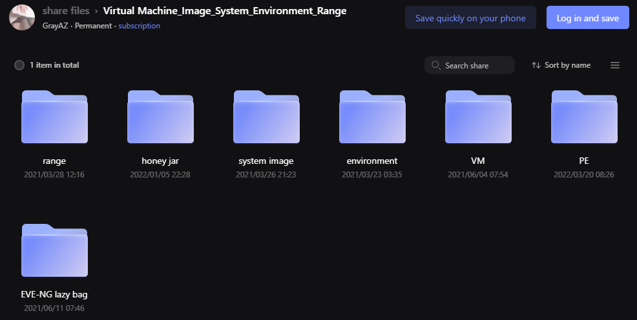
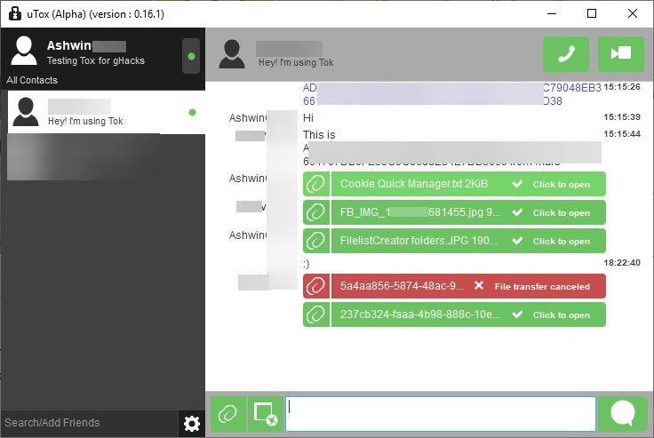

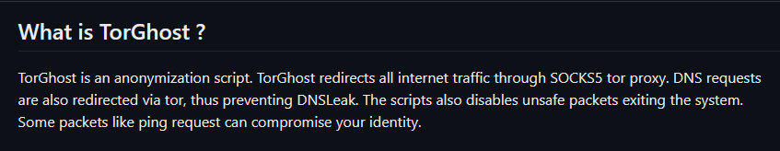
Protect Yourself
https://github.com/SusmithKrishnan/torghost
Notes:
Use an encrypted VM
Use TOR and Tox
Shut your mouth
Don’t buy a lambo or g wagon

Slide 7
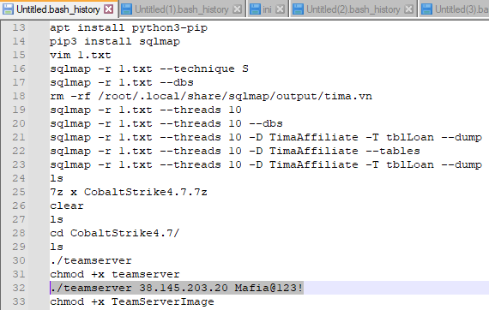
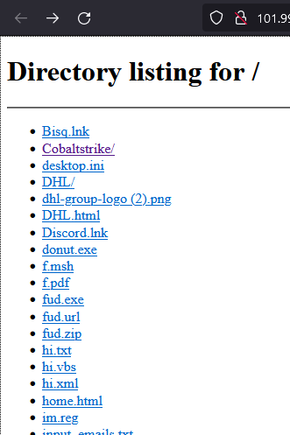
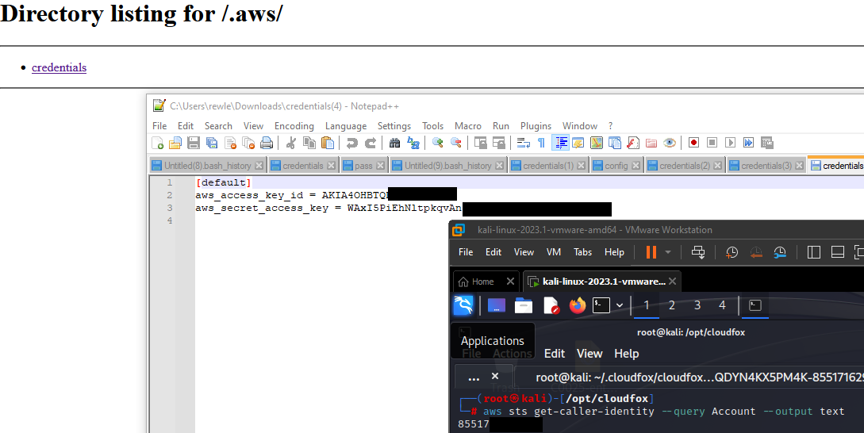
Protect The Company
Notes:
Take your time explaining this. How it was found etc Don’t pull an NSA and leave our whole stack – Here’s an example of a former affiliate we fired after leaking our entire stack causing it to get signatured. Another one left bash history with creds to cobalt strike and last but not least an AWS environmental variable left out in the open that resulted in “The good guys” connecting to our AWS, Destroying 15 running operations and bragging about it on twitter.
Don’t save chats
Practice good hygiene when building infrastructure use reverse proxies and don’t leave login portals out in the wind.
Don’t talk to reporters

Slide 8
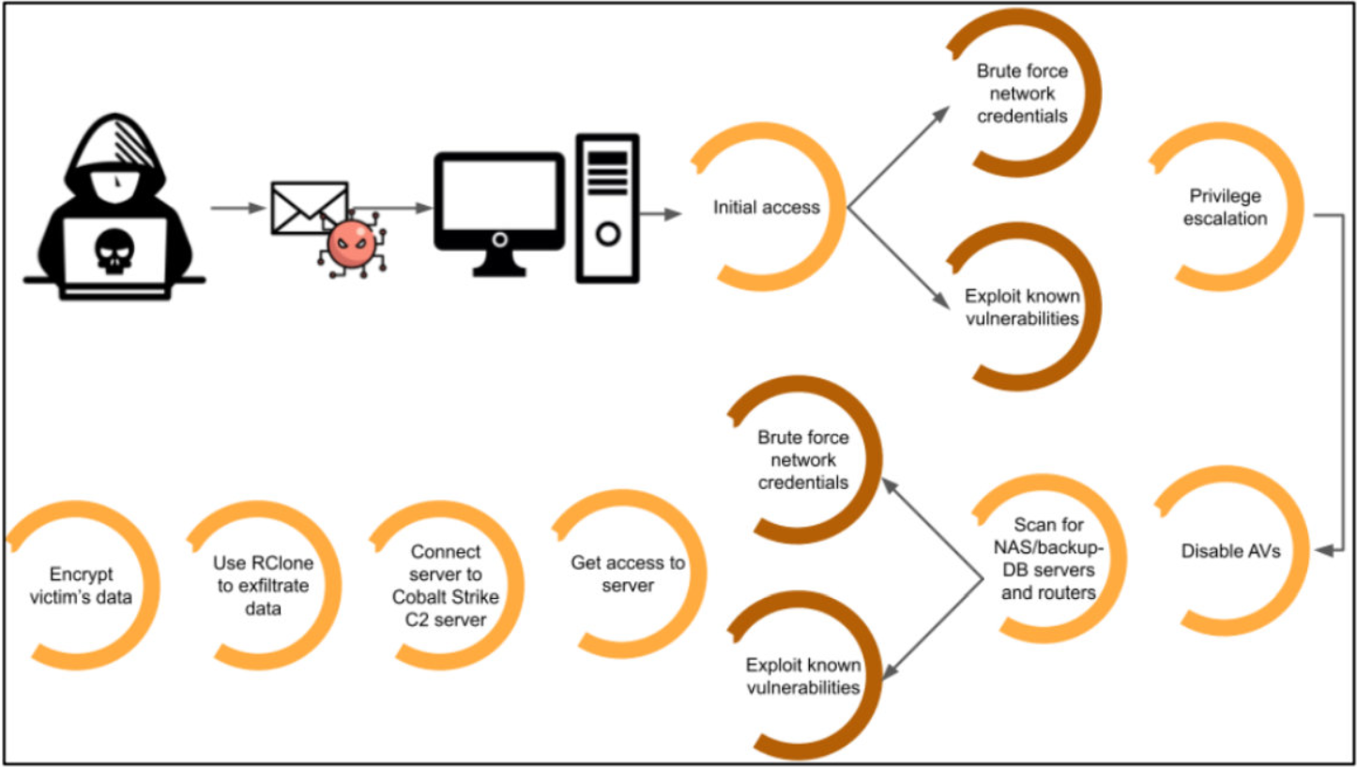
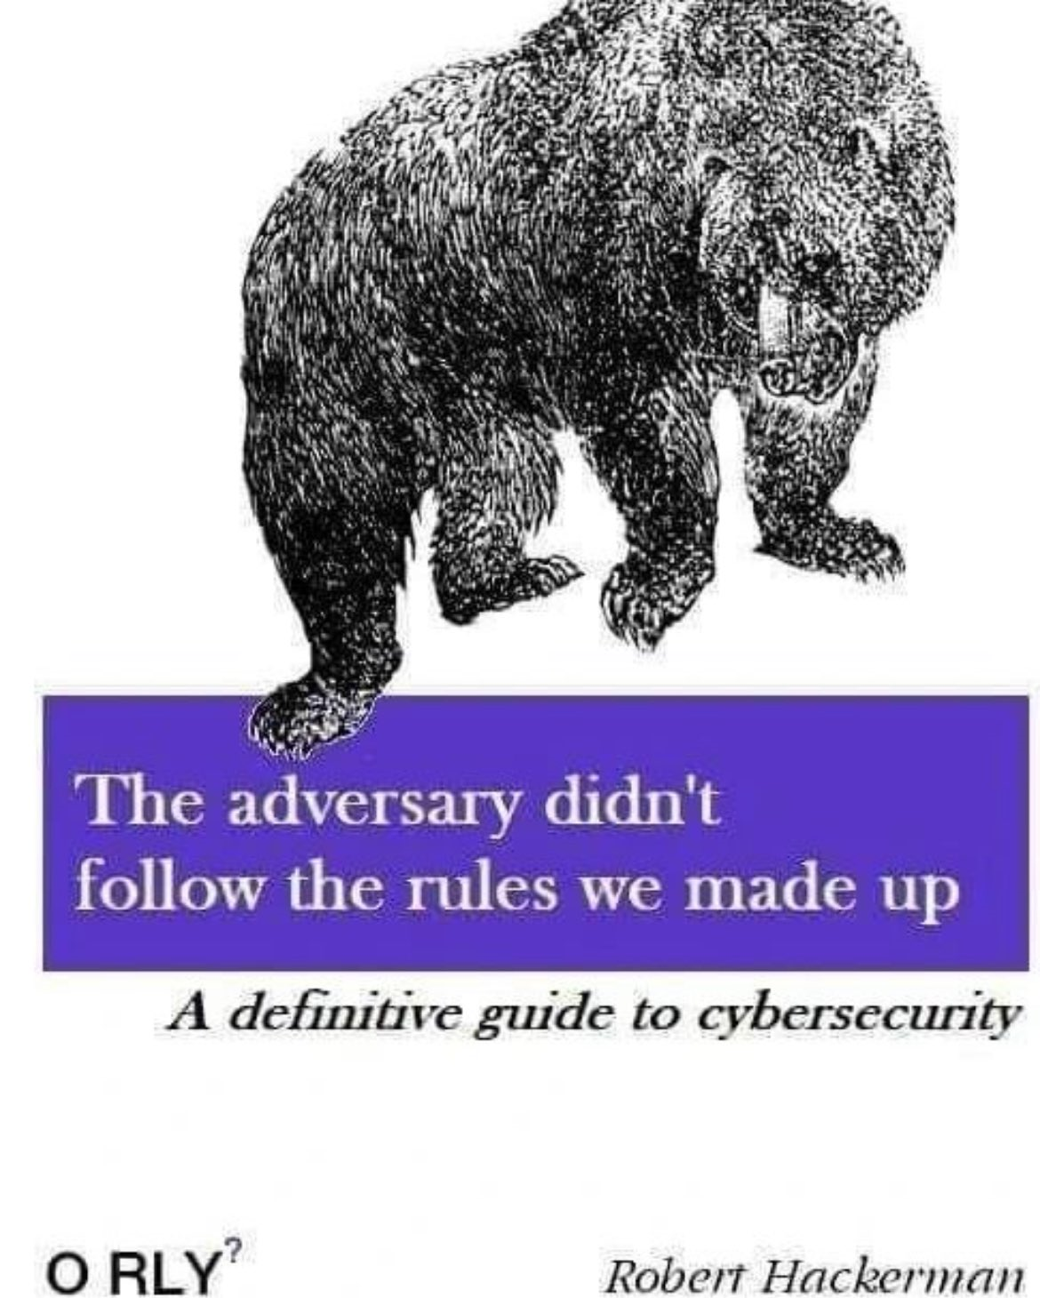
Our process
Notes:
Build a repeatable model – we aren’t creating masterpieces we aren’t picaso or even bob ross we’re painting by number. Pentesting isn’t artistic expression it’s a rigid by the book process guaranteed to deliver results. Think of it as knowing the answer by looking at the math problem vs showing your work. With our process even non-technical affiliates can achieve stellar results.
By following a documented process you can ensure success, minimize dwell time, maximize payout and cripple operations to ensure payout.
We don’t know what mitre is, we don’t follow it, it’s an adversaries attempt to make sense of why they got beat. Tf is mitre

Slide 9
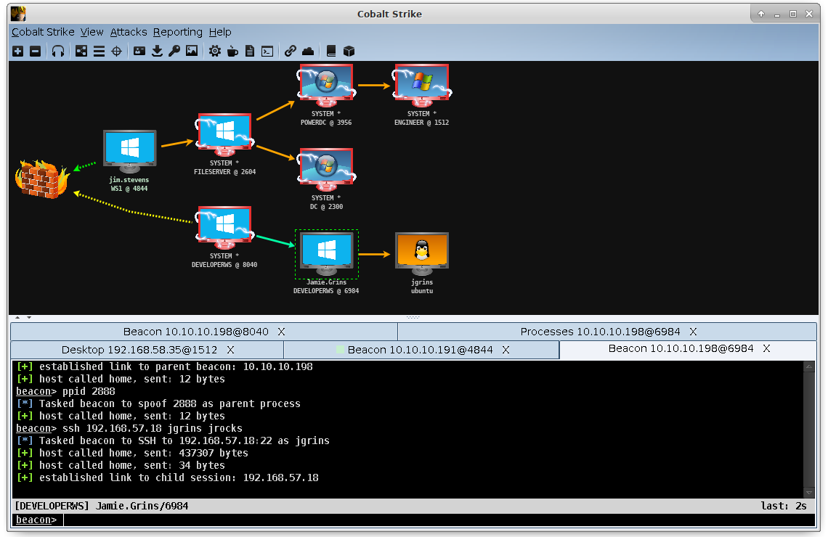
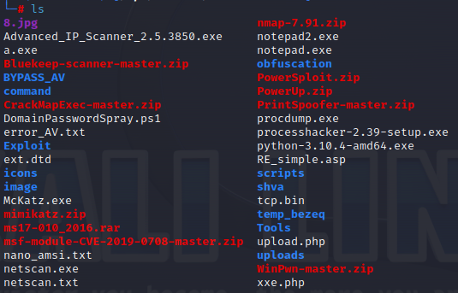
Our Tools
Manuals: https://talosintelligence.com/resources/302
Notes:
Deep dive into tools for time. Cobalt strike is explained later.
We’ll be providing a link to manuals as well as a link to the tools needed. Our primary tool is cobalt strike a command and control framework that allows for easy pivoting and operations overview as well as multi player teaming.

Slide 10
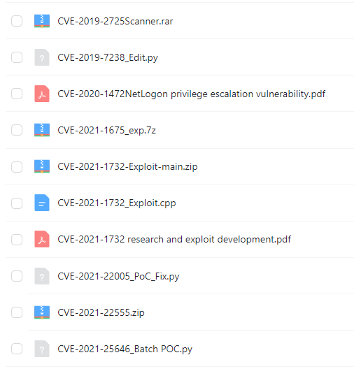
Initial Access
Scan away
Spray and Pray
Pay to Play
Zero day
https://www.cisa.gov/known-exploited-vulnerabilities-catalog
Notes:
This is the hard part. After this it’s all down hill from here
Scan away – Special thanks for CISA for providing a list of the most exploitable vulns search for ones that haven’t been patched
Spray and pray – Mass email phishing campaigns or password spraying company websites and VPN.
Pay to play – Leverage initial access brokers to cut down on the hard part
Zero day – By far the most successful way to gain access. Hit them where they don’t know
Explain that the redteam and devs will be providing you with the latest and greatest zero days.

Slide 11
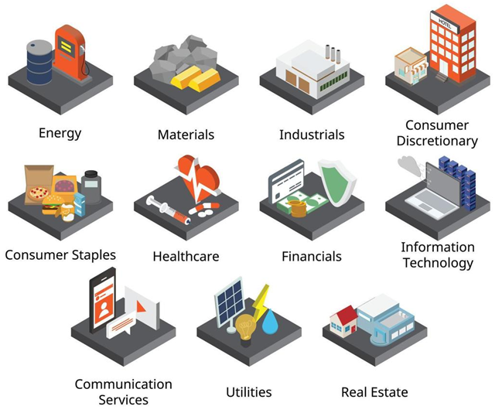
Getting To Know Our customers
Use OSINT to determine
Revenue
Industry
Decision Makers
Customers
Notes:
As an affiliate of ransom corp you find yourself among the most elite hackers offering penetration testing services to clients
Revenue - zoominfo
Industry – Are they bound by any compliance
Decision Makers – who to target and who will be making decisions
Customers – Who the industry services to apply additional stress and leverage.
We don’t work directly with hospitals and non profits as they typically do not have the funds to pay for our services and cause negative impact to our image if we target them.

Slide 12
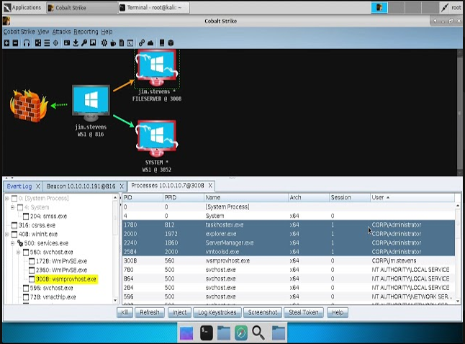
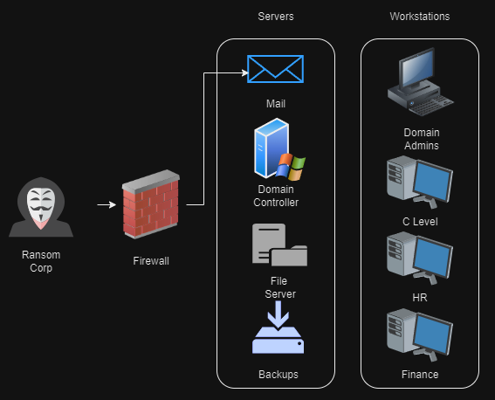
Escalating Access
Notes:
Certain workflows make our lives easier. Admins think they want to protect workstations or that intrusions start with users. With hafnium we got shells directly on Mail servers in the server vlan, with a domain admin.
Don’t discount workstations importance we’ll be discussing this further on finding leverage
Explain access with CS We can steal the token of any needed user.
Mimikatz is meh.
Hunting admins
Getting domain admin
Access domain controller
Exfil ntds.dit and set reversible encryption

Slide 13
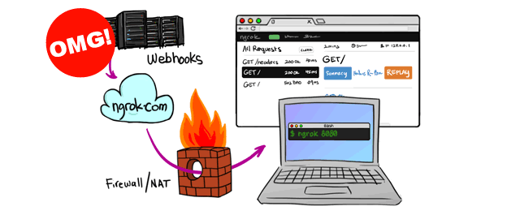
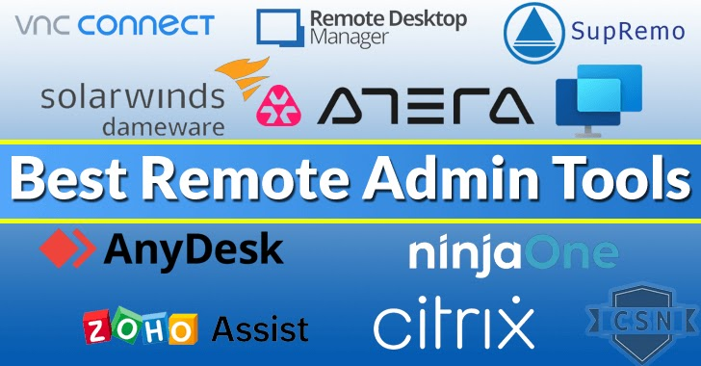
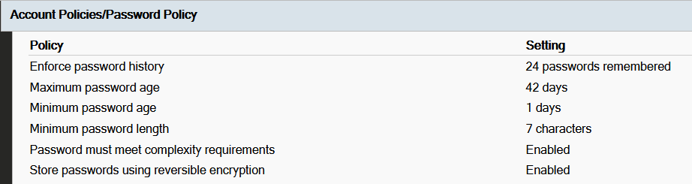
Maintaining Access
Notes:
Ngrok
Anydesk
Reversible encryption

Slide 14
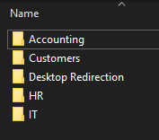
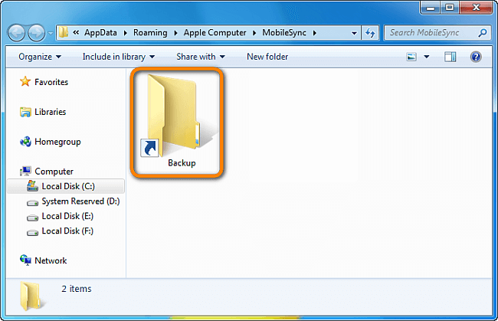
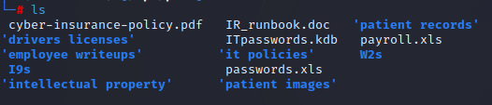
Finding Leverage
Notes:
There’s a term we learned in our finance class called grease money, it’s not a “bribe” it’s money used to get the process moving. After gaining full domain control we need to find data we can use as lubrication to continue momentum through out negotiations.
Find network shares
Files we're looking for business, clients
Embarrassing material
Cyber insurance policy BIG ONE

Slide 15
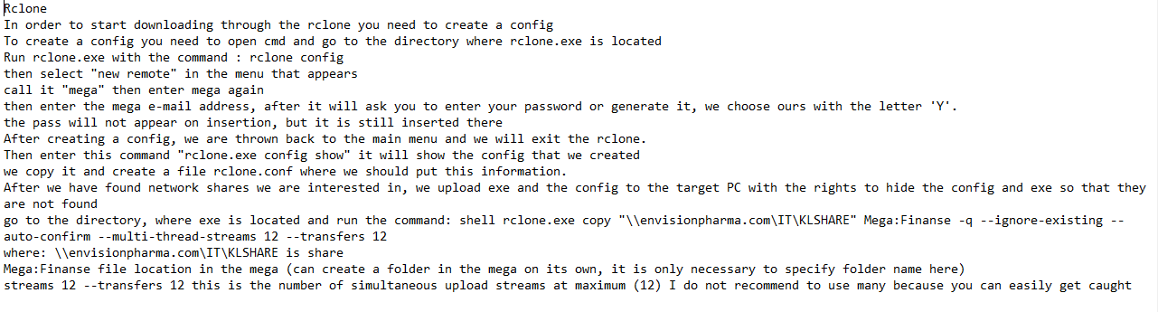


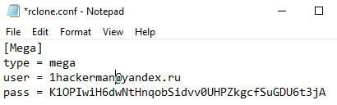
Exfil
Notes:
Mega
Rclone
Once you’ve got the data you need to get it out. Here’s our preferred process since mega has yet to shut us down.

Slide 16
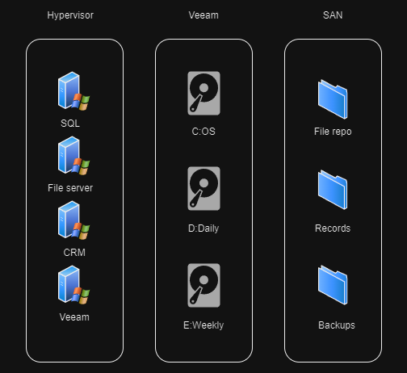
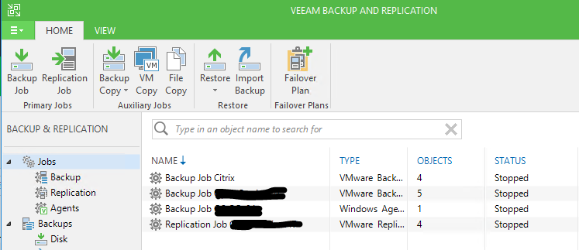
Impact
Notes:
Destroy backup compromise backup integrity
After you get through destroying veeam backups, s delete from sysinternals on the drive the rest is on the next slide for the vmware and SAN portion

Slide 17
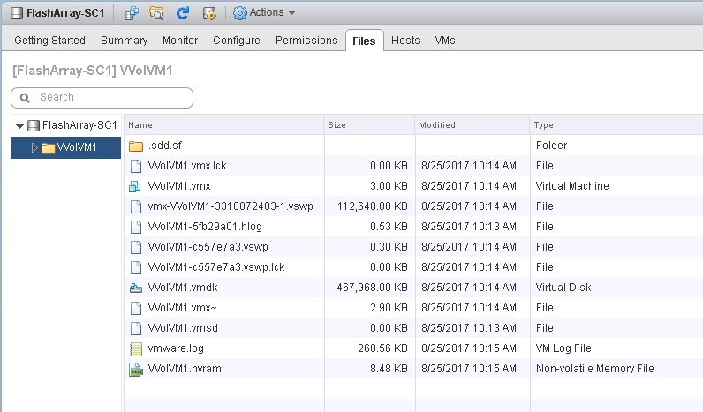
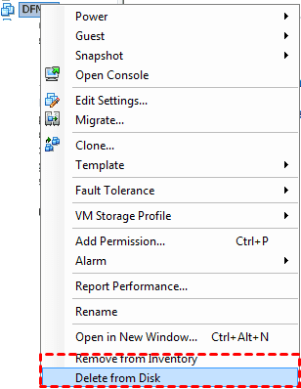
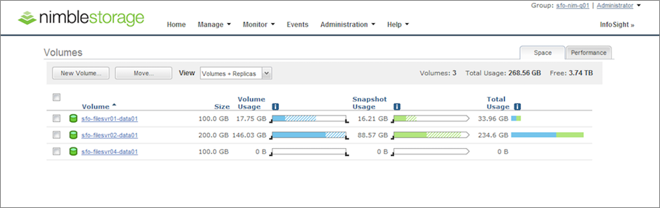
Impact
Notes:
Destroy backup compromise backup integrity

Slide 18
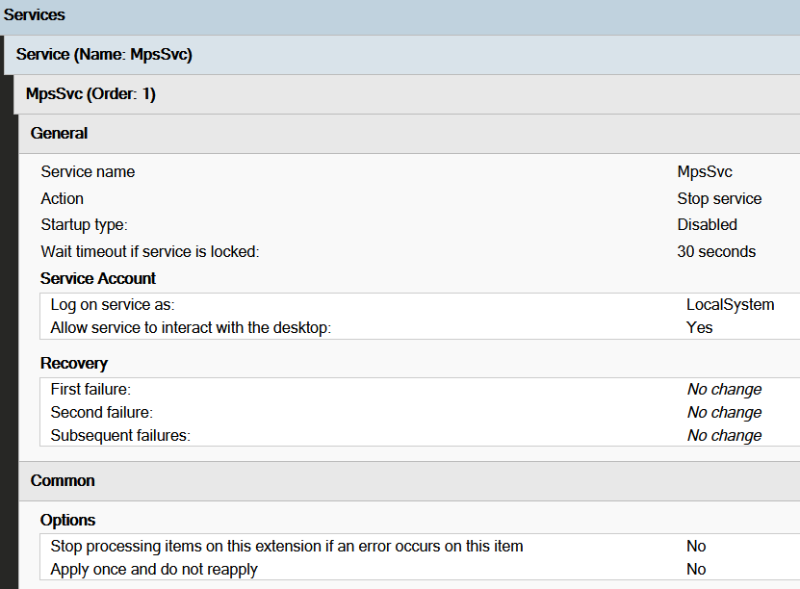
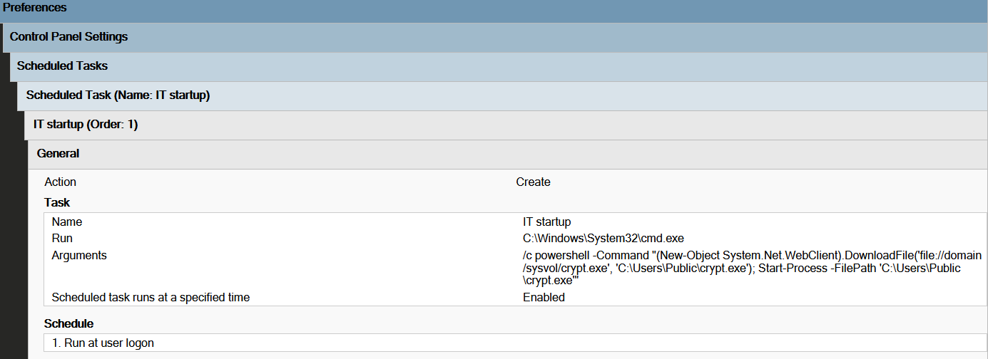
Impact
Notes:
Since we have full domain access
Disable anti-virus
Deploy locker
Defender makes our life easier. In the event we encounter an anti-virus such as Sentinel One or Crowdstrike we’ll leverage the browser pivot function of cobalt strike to access the console from an admins machine. Should an admin have 2fa enabled we suggest triggering a false positive detection with eicar to motivate them to login.

Slide 19
Example small business workflows
Notes:
While our product is typically aimed at small medium business we don’t discriminate against the startup or mom and pop shops.
We use inhouse developed tool scvhost tool to disable AV and start the data exfil process, next mimikatz is used to gain credentials that can be used for lateral movement and finally we deploy our ransomware and desktop locker this workflow is popular on networks without a domain controller or active directory, think dentist office or church

Slide 20
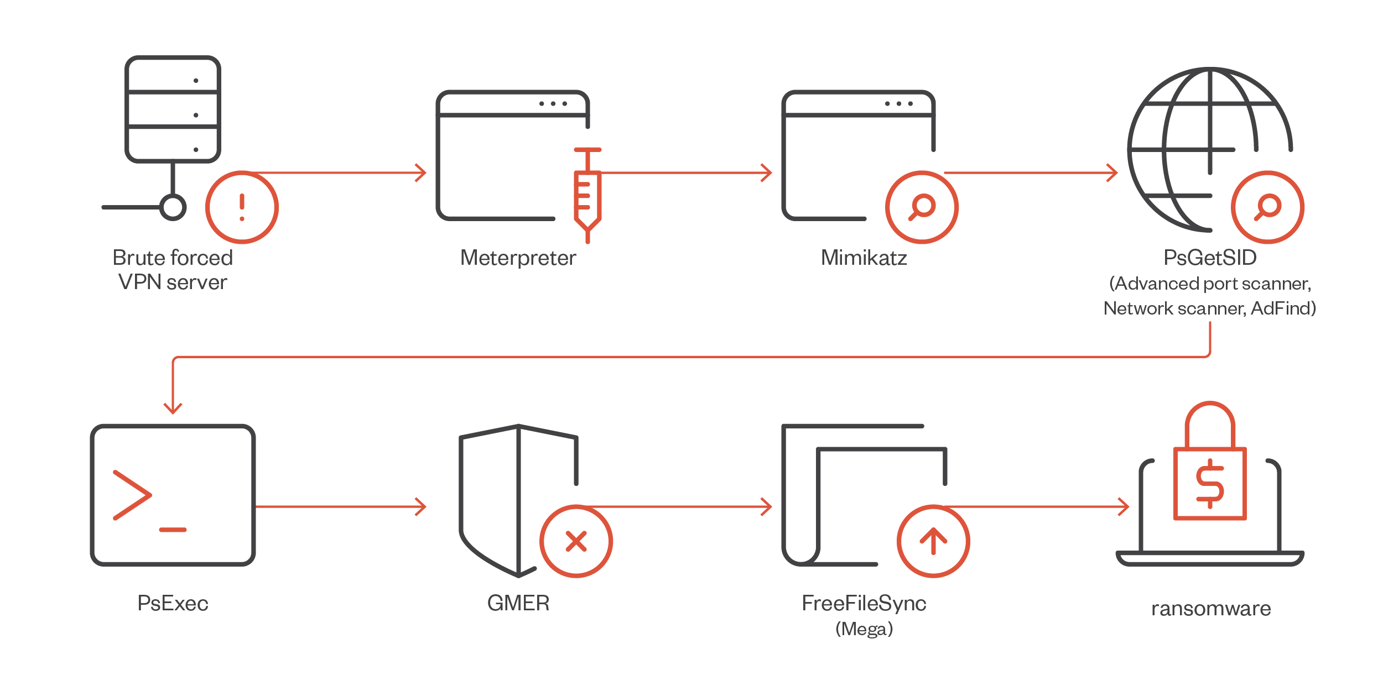
Example workflows
Notes:
A more advanced attack leverages Metasploit along with cobalt strike for remote access. Next mimikatz is used to obtain credentials and targets for lateral movement are identified using a slew of windows specific tools. Once domain level creds are obtained psexec is executed at admin level to gain system level shells. From a system level shell we deploy gmer the popular rootkit removal tool to disable the filter drivers leveraged by AV to detect and stop our ransomware, next we use rclone with mega to exfil data before finally deploying our crypter.

Slide 21
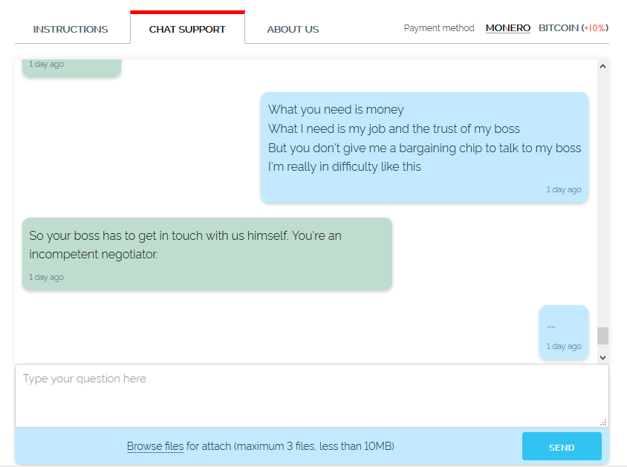
Negotiation
Notes:
Proof of life
Think of it less as blackmail and more and negotiation lubrication
Ransom amount set at 3% of company revenue
Maximum discount of 1.5%
Remember that file from earlier. If found ransom is the amount covered by cyber insurance maximum discount 50%
This isn’t a charity. Don’t waste time with morons. If they attempt to bargain after the final offer first threaten with scorched earth, and if they don’t play ball deliver the final blow.

Slide 22
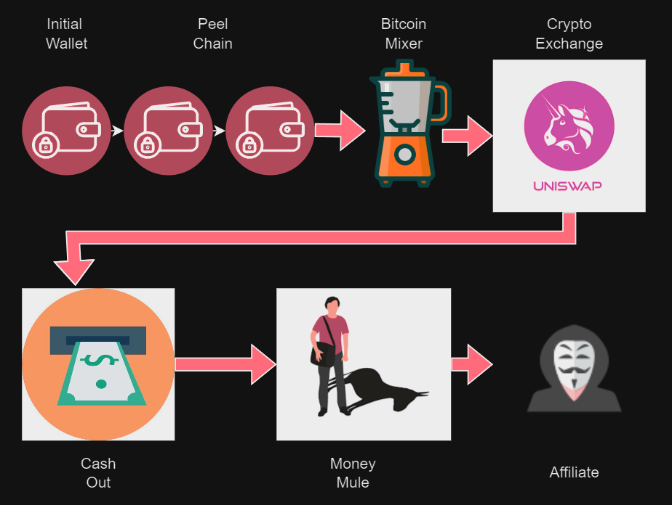
Getting paid
Notes:
Provide the client with the wallet as part of the ransom note. Funds that hit the initial wallet are spidered and divide amongst a peel chain (a chain of dozens of wallets. Next it’s uploaded to a mixing or tumbling service. The funds are then added to a crypto exchange with an insider that works for us that can cash us out. Mules pick up the cash and deliver or ship the money to a location of your choosing. Once payment is deposited you sit back and relax and wait for a big bag of cash.

Slide 23

Closing thoughts
Notes:
Final notes. If you get stuck and need help completing a job, you can engage our level 2 support engineers to assist you for a percentage of the payout. Our on call support staff is here to make sure our product is used effectively and to make you look great.

Slide 24
Thank You

